Slide 1
What’s Cooking?
Group 13

Slide 2
How to predict Cuisine from ingredients?
Need to train classifier to predict
Classifier
Ingredients
Cuisine

Slide 3
Training Data
Training data sample

Slide 4
Testing Data
Testing data sample

Slide 5
Methodology and Tools
Preprocessing parameter tuning
Classifier parameter tuning
Classifier weight tuning
Classifier ensemble
Cross-validation

Slide 6
Problem definition
understand data
Data clean & preprocess
DTM
Train model
parameter tuning
TF-IDF
Ensemble result
K fold cross validation
Validation result
Use probability as input

Slide 7
Methodology and Tools
Preprocessing parameter tuning
Pipeline
GridSearchCV
vectorizer.fit_transform(): DTM
TfidfTransformer: TFIDF

Slide 8
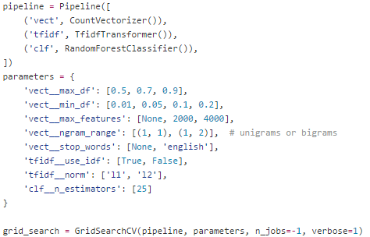
Preprocessing parameter tuning
Test how well each preprocessing parameter behave
Pipeline
GridSearchCV

Slide 9
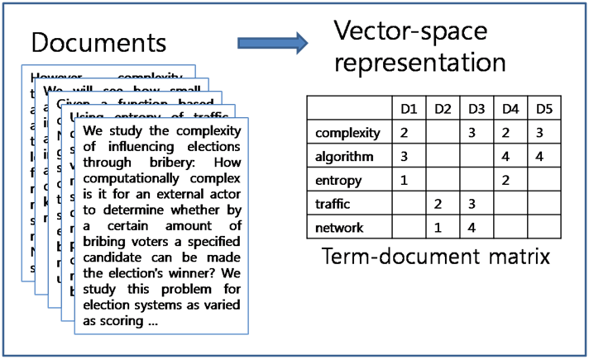
DTM

Slide 10
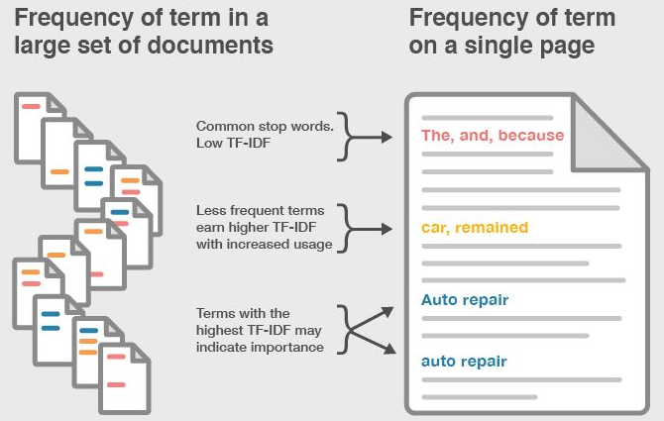
TFIDF

Slide 11
Methodology and Tools
Classifier parameter tuning
GridSearchCV
RandomSearchCV

Slide 12
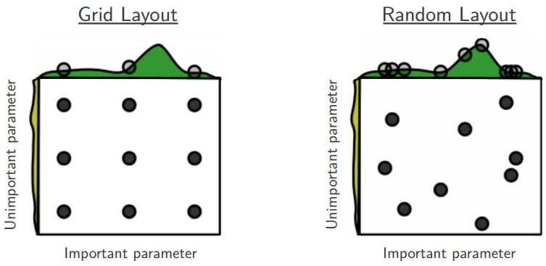
GridSearch & RandomSearch

Slide 13
Methodology and Tools
Classifier weight tuning
Weighting tuning (maunally)

Slide 14
Methodology and Tools
Classifier ensemble
Use probability

Slide 15
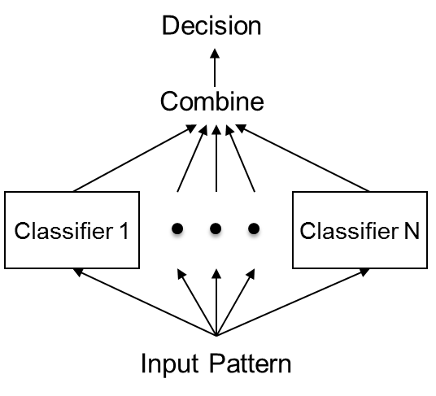
Classifier ensemble

Slide 16
Methodology and Tools
Cross-validation
K-fold (5-fold)

Slide 17
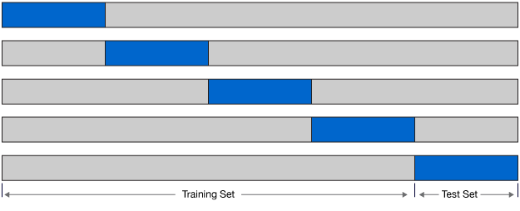
K-fold

Slide 18
Experimental Result: Parameter Tuning
Xgboost: score: 0.8(std: 0.001)
SGDClassifier
Mean validation score: 0.782 (std: 0.002)
Parameters: {'penalty': 'elasticnet', 'l1_ratio': 0.1, 'loss': 'modified_huber'}
ExtraTree
Mean validation score: 0.765 (std: 0.003)
Parameters: {'max_features': 6, 'n_estimators': 100, 'criterion': 'gini', 'max_depth': None}
LogisticRegression
Mean validation score: 0.786 (std: 0.001)
Parameters: {'penalty': 'l2', 'C': 8, 'tol': 0.01, 'dual': False}

Slide 19
Expearimental Result: Parameter Tuning
LinearSVC
Mean validation score: 0.788 (std: 0.001)
Parameters: {'penalty': 'l2', 'C': 0.4, 'tol': 0.001, 'dual': False}
KNN
Mean validation score: 0.747 (std: 0.002)
Parameters: {'n_neighbors': 16, 'weights': 'distance', 'leaf_size': 222, 'algorithm': 'kd_tree'}
Random Forest
Mean validation score: 0.764 (std: 0.002)
Parameters: {'bootstrap': False, 'min_samples_leaf': 1, 'n_estimators': 275, 'min_samples_split': 3, 'criterion': 'gini', 'max_features': 43, 'max_depth': None}

Slide 20
Experimental Result: Classifer weighting
Total: 14 different classifiers (classifier_1 ~ classifier 14)
There are 7 algorithms
Each algorithm uses two different training data (raw or Tfidf)
Predicted Result: 0.81376 (Private Rank 62) v.s 0.83216(Rank 1)
Name | Raw accurancy | Raw Weighting | Tfidf accurancy | Tfidf Weighting
Random Forest | 0.764 | 1.5 | 0.759 | 1.5
Extra Tree | 0.765 | 1.8 | 0.748 | 1.8
SGD | 0.763 | 1.0 | 0.782 | 1.0
Logistic Regression | 0.781 | 2.0 | 0.786 | 2.0
XGboost | 0.802 | 3.0 | 0.807 | 3.0
KNN | 0.649 | 0.5 | 0.745 | 1.0
MultinomialNB | 0.726 | 1.0 | 0.734 | 1.0

Slide 21
Lesson Learn
Preprocessing
Parameter tuning
DTM & tfidf
Classifier
Parameter tuning
Ensemble
Weight tuning
Cross-validation

Slide 22
Stacked Generalization
Split the training set into two disjoint sets.
Train several base learners on the first part.
Test the base learners on the second part.
Using the predictions from 3) as the inputs, and the correct responses as the outputs, train a higher level learner.

Slide 23
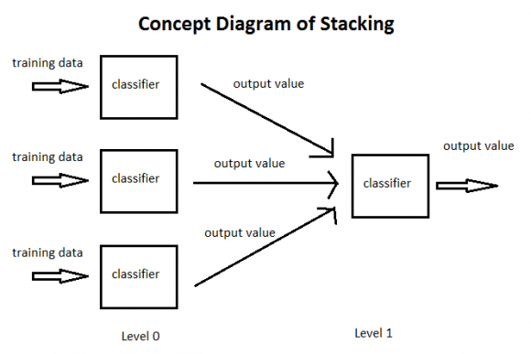
Stacked Generalization

Slide 24
Q&A

